Slide 1

Regional Sales Analysis – Exploratory Data Analysis (EDA)
Codecademy Data Analytics with AI Bootcamp – 2025
Danny Chacon

Slide 2
Approach
Collect and review the Regional Sales Dataset (2014–2018).
Explore dataset structure: Sales Orders, Customers, Products, Regions, Budgets.
Perform data cleaning and preparation for analysis.
Conduct Exploratory Data Analysis (EDA) to uncover trends and insights.
Special focus: Compare 2017 Budgets vs. actual sales (Line Total) to evaluate performance.
Identify over- and under-performing products.
Provide strategic recommendations based on findings.

Slide 3
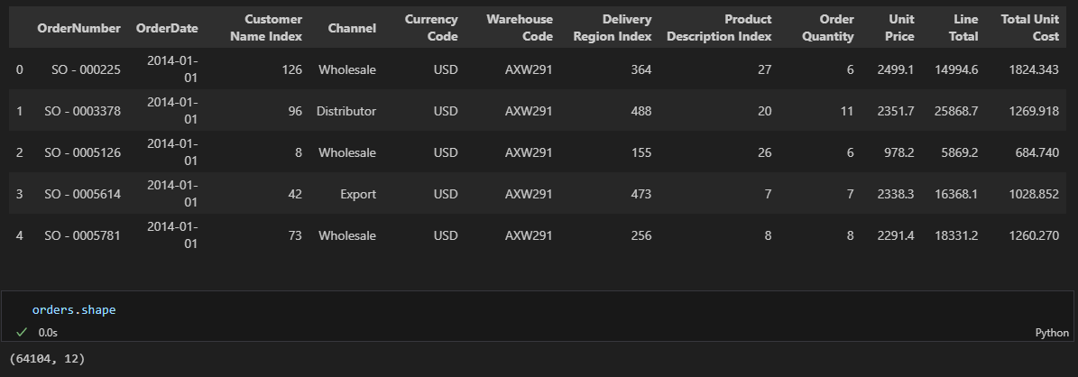
Data overview
Dataset covers 2014–2018 sales transactions.
Sales Orders table: 61,404 rows × 12 columns.
Key fields: Order Number, Order Date, Channel, Product, Line Total, Profit.
Other tables: Customers, Products, Regions, State Regions, 2017 Budgets.

Slide 4
Project workflow
Data understanding
Exploratory data analysis (EDA)
Key insights
Data collection
Data Cleaning and preparation
Final recommendations

Slide 5
Key Insights
Sales remained stable between 2014–2016 (~298M USD/year) but dropped sharply in 2018 (~48M).
A small group of products drives the majority of revenue (top 3 products >40%).
One channel dominates sales, creating dependency risk.
California and Illinois lead in sales (>100M USD), while most states contribute marginally.
In 2017, several products exceeded budget forecasts, but some underperformed significantly

Slide 6
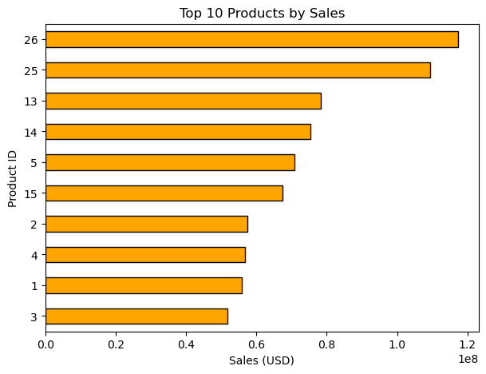
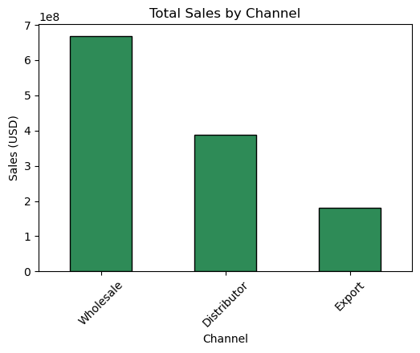
Graphs

Slide 7
Recommendations
Diversify channels to reduce dependency on a single distribution strategy.
Focus investment on high-performing products while reassessing low-selling ones.
Expand operations in top states (California, Illinois, Florida) and explore growth opportunities in underperforming regions.
Improve forecasting accuracy for budgets to better align expectations with reality.
Investigate the 2018 sales drop to confirm whether it is due to incomplete data or real market decline.

